Slide 1
API SERVER PRESENTATION
wisoft Seongwon Lee

Slide 2
API SERVER PRESENTATION

Slide 3

API SERVER PRESENTATION
Jersey

Slide 4
API SERVER PRESENTATION

Slide 5
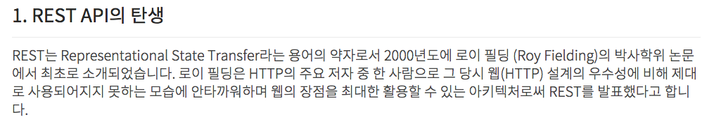
API SERVER PRESENTATION

Slide 6
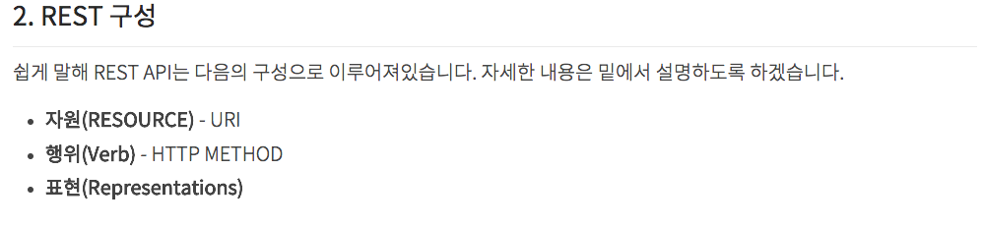
API SERVER PRESENTATION

Slide 7
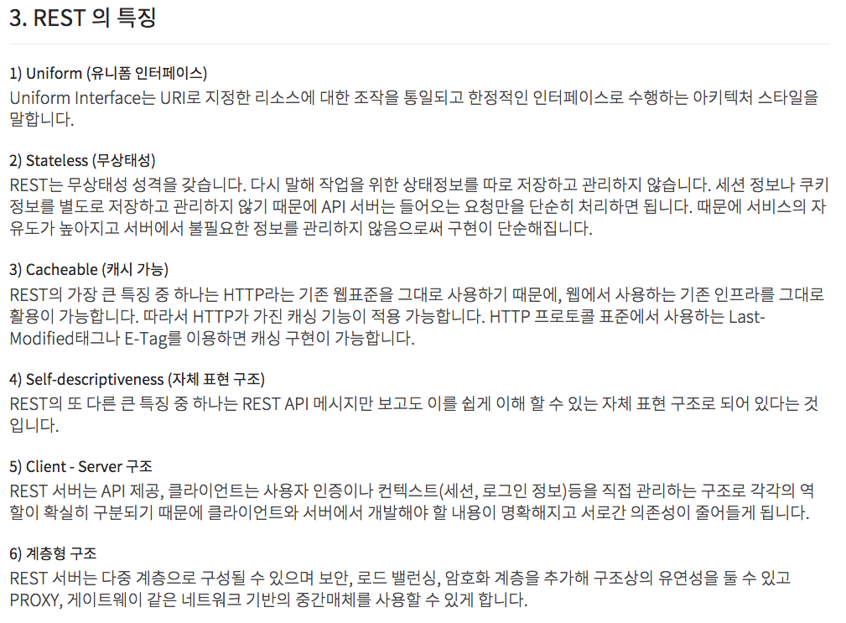
API SERVER PRESENTATION

Slide 8
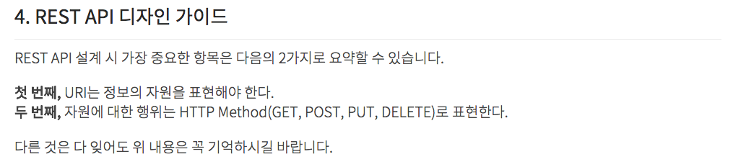
API SERVER PRESENTATION

Slide 9
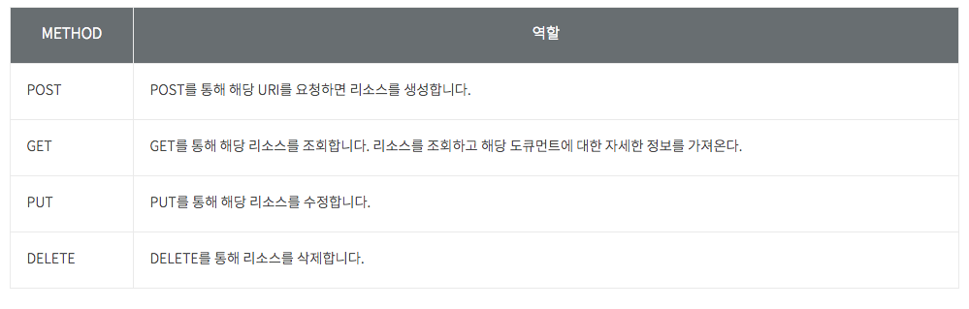
API SERVER PRESENTATION

Slide 10
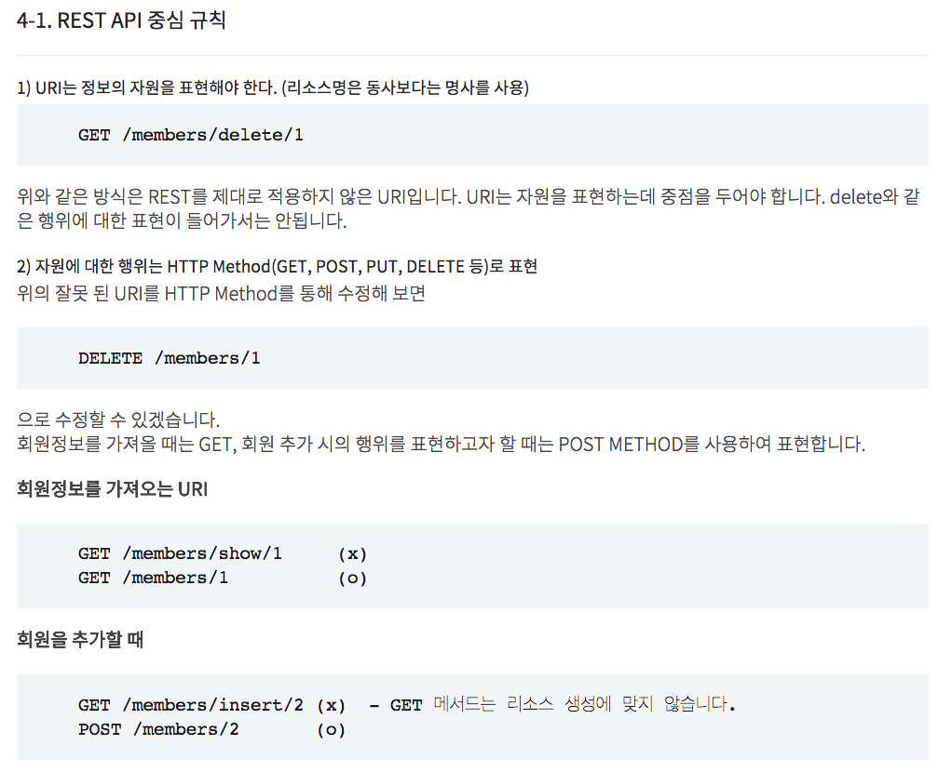
API SERVER PRESENTATION

Slide 11
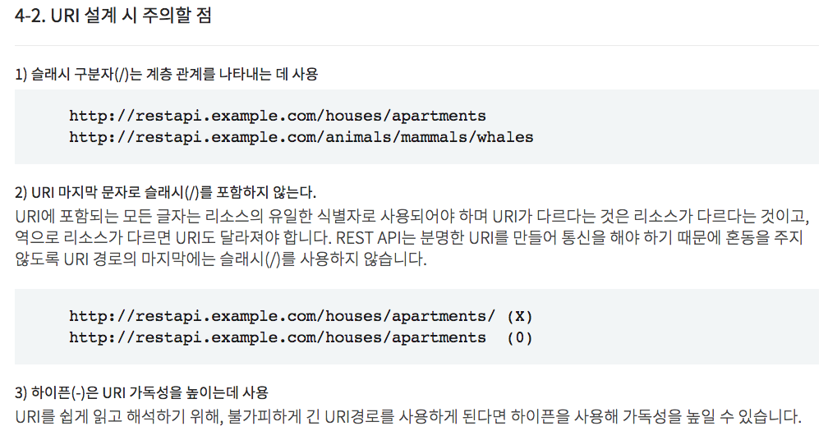
API SERVER PRESENTATION

Slide 12
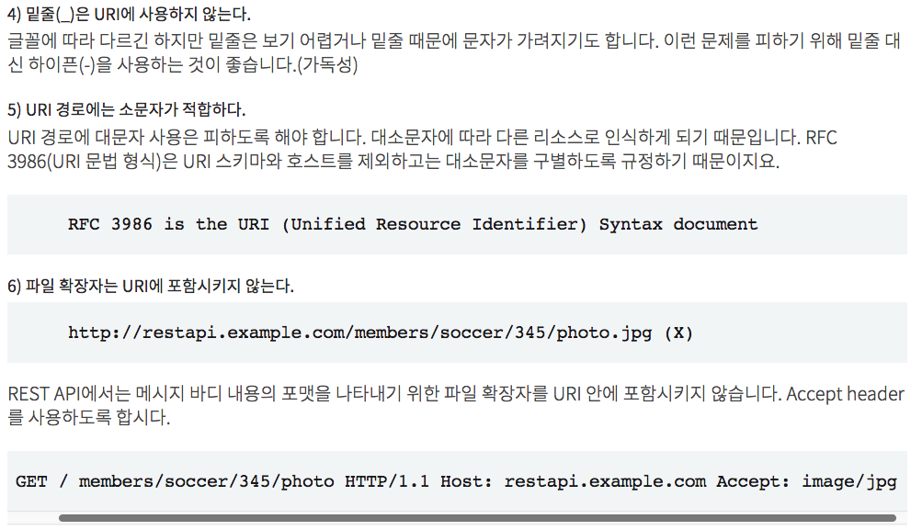
API SERVER PRESENTATION

Slide 13
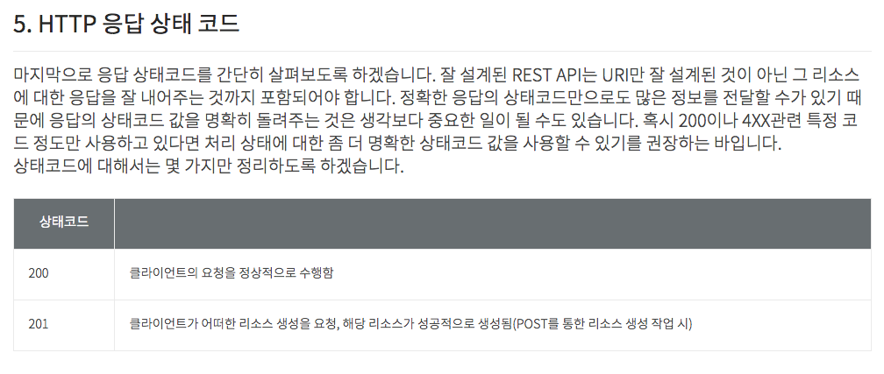
API SERVER PRESENTATION

Slide 14
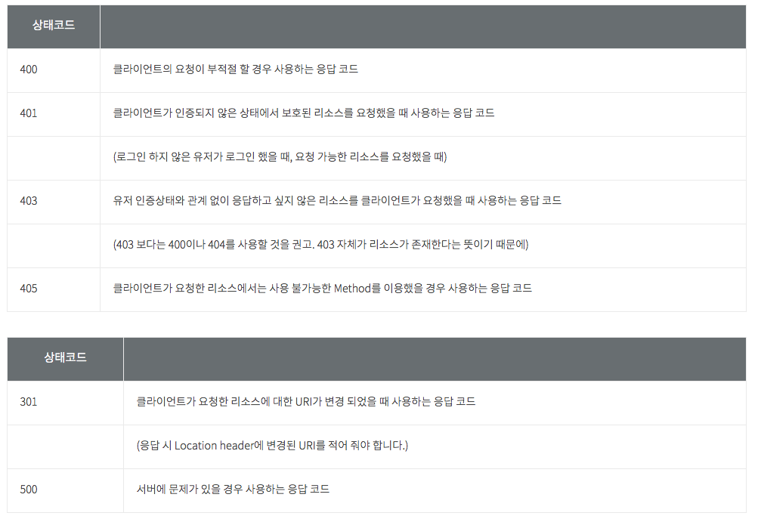
API SERVER PRESENTATION

Slide 15
API SERVER PRESENTATION

Slide 16
API SERVER PRESENTATION

Slide 17
실습해 봅시다

